Slide 1
Workato Product Overview Presentation

Slide 2
Agenda
01
06
Introductions
Data Orchestration
07
Master Data Management
02
Workato ONE Marketecture
08
Agentic AI
03
Workato iPaaS
09
AIRO
04
Workato APIM
10
IDP
05
11
Security and Governance
Workato EDI

Slide 3


Slide 4
















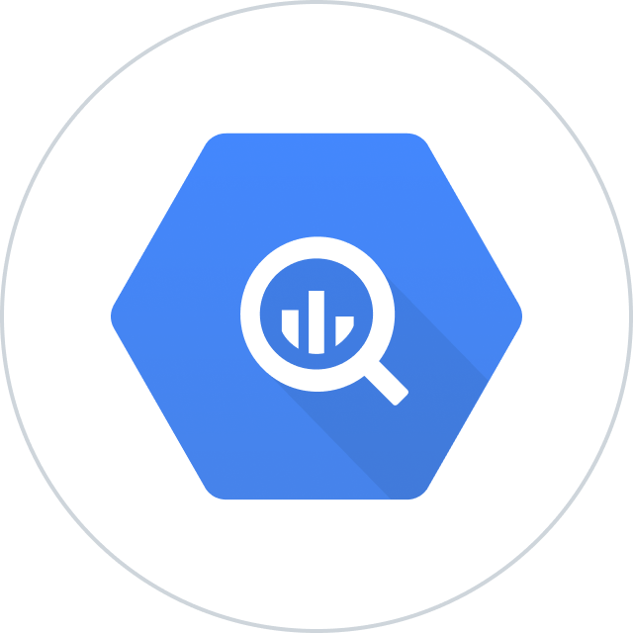


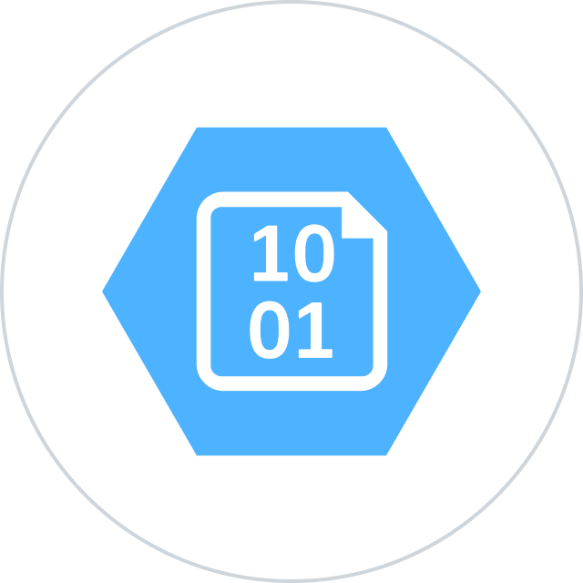


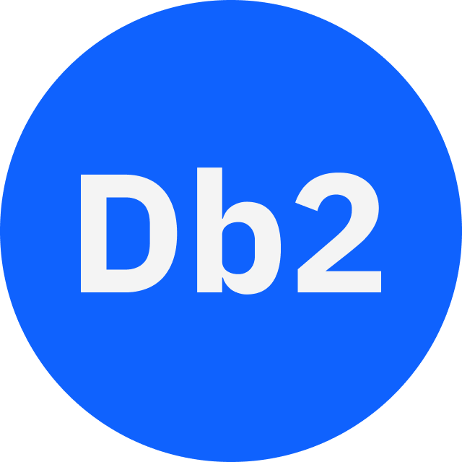













Orchestration for the Agentic Era—Powered by the #1 iPaaS.
I
Build agents with us
Go faster with Enterprise Skill packs and Workato Genies
W O R K A T O E N T E R P R I S E M C P
P L A T F O R M A G E N T S
E N T E R P R I S E S K I L L S
T R U S T
MCP Gateway
Observability
Solution Architect (AIRO™)
Skills Builder
MCP Composition
MCP Registry
MCP Proxy
Governance
Platform Agents
Solution Architect (AIRO™)
Operations Analyst (Acumen)
O R C H E S T R A T I O N
Security
Data Scientist (Acumen)
Process Automation
Application Integration & B2B
Compliance
Data Orchestration
API Management
Explainability
Powered by iPaaS+
U N I V E R S A L C O N N E C T I V I T Y
SaaS/On-prem
Data Warehouse/ Data Lakes
Databases
LLMs
Unstructured
Traditional
Invoice
Media
Transcripts
Contracts
SFTP
Mainframe
Custom
Archives
Notes:
This is Workato ONE —Orchestration for the Agentic Era—Powered by the #1 iPaaS.
Unlike solutions that give you pieces of the puzzle, Workato ONE delivers the complete agentic enterprise:
Workato ONE One platform for data, apps, and agents
Workato GO puts enterprise search with Deep Action™ directly in every employee's hands
Workato Agentic builds and deploys production-ready agents with full enterprise context
Workato Enterprise MCP One trusted bridge for every agent to connect to applications and systems safely and securely
Workato Orchestrate powers complex workflows across teams, systems, and agents
All built on universal connectivity to 10,000+ applications and data sources
What makes this different? True Enterprise Orchestration.
Everyone talks about integration—APIs, MCP, basic workflows. But enterprise orchestration is fundamentally different. It's:
Transactionality that ensures every action completes or rolls back cleanly
In-sequence and exactly-once delivery so your financial transactions never duplicate
Runtime authentication and RBAC that enforces your security policies in real-time
PII obfuscation and data governance that maintains compliance automatically
Event-driven, batch, and real-time triggers that handle any integration pattern
Plus something no one else has: 1 million+ Enterprise Skills—pre-built, production-tested capabilities that encode your business logic, not just API calls. When an agent needs to "process a return," it doesn't just update a field—it orchestrates the entire business process across systems, with all the exception handling, approvals, and compliance checks your enterprise requires.
This unified approach enables true multi-agent orchestration. Your agents don't just connect—they inherit your enterprise's operational intelligence.

Slide 5
Workato iPaaS

Slide 6
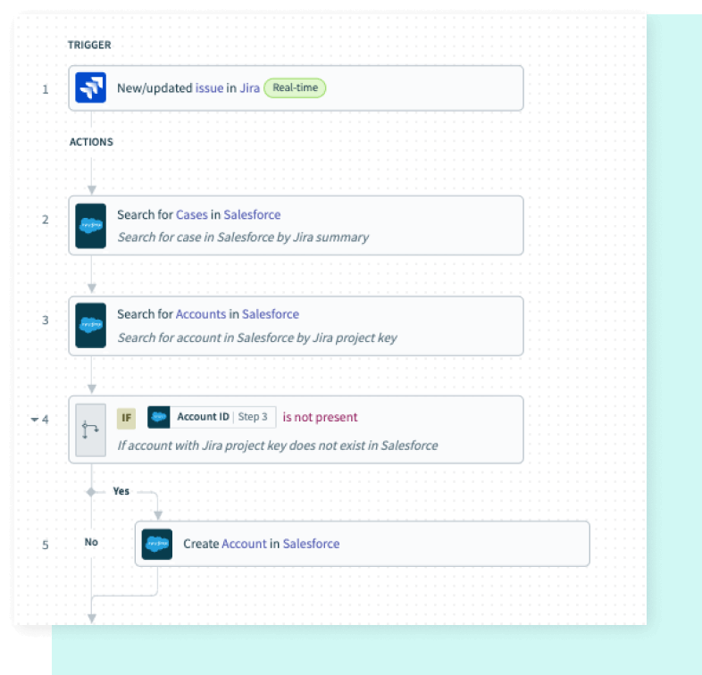
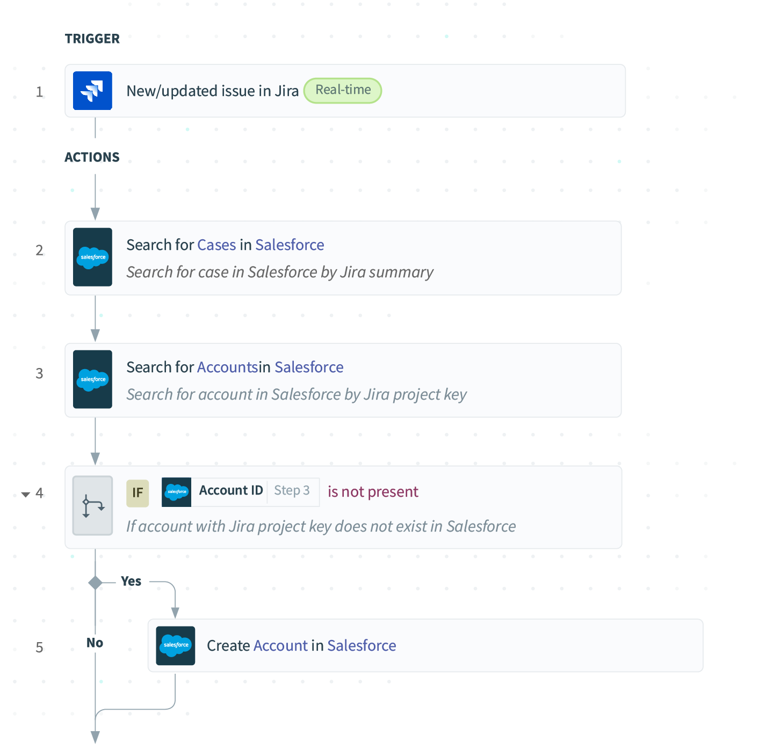
Workato iPaaS
Orchestrate data, apps, and APIs through a single platform
Features
Unified enterprise platform
AI-assisted recipe development
Connect to 12,000+ apps
Benefits
Accelerate integration delivery
Scale Securely with zero downtime
Gain insight and visibility
Notes:
Workato iPaaS is the core of our platform — it unifies integrations, automations, and APIs in one place.
Challenge: Most organizations are still juggling dozens of disconnected tools and manual processes to move data across systems. Integration projects take months and often rely heavily on IT.
Impact: “That slows down innovation — teams can’t automate quickly, and changes across systems introduce risk or downtime.
Solution: Workato iPaaS unifies integration, automation, and orchestration into one AI-powered platform. With 12,000+ pre-built connectors and AI-assisted design, teams can build and deploy workflows 10x faster — all with enterprise-grade security and governance.
Payoff: That means faster integration delivery, zero downtime, and complete visibility into business-critical workflows — empowering every team to move at the speed of the business.
Key Features
Unified Enterprise Platform Connect applications, data, and teams on a single platform that combines integration, automation, and orchestration — all governed by enterprise-grade controls.
AI-Assisted Recipe Development Accelerate project delivery up to 10x faster with an intuitive, AI-powered builder. Use natural language prompts and AI copilots to create integrations and workflows in minutes.
Connect to 12,000+ apps Tap into a vast library of pre-built connectors and templates, enhanced by AI copilots, to streamline integration efforts and reduce development overhead.
Benefits
Accelerate Integration Delivery Speed up integration and automation projects using AI-powered design, prebuilt connectors, and reusable components — from build to deployment.
Scale Securely with zero downtime
Empower more teams while maintaining control through robust governance, role-based access, and compliance with standards like SOC 2, GDPR, and HIPAA.— all on a platform that delivers zero-downtime upgrades for uninterrupted operations.
Gain insight and visibility Gain real-time visibility into workflows with built-in monitoring and analytics to detect errors, optimize performance, and demonstrate business impact.

Slide 7
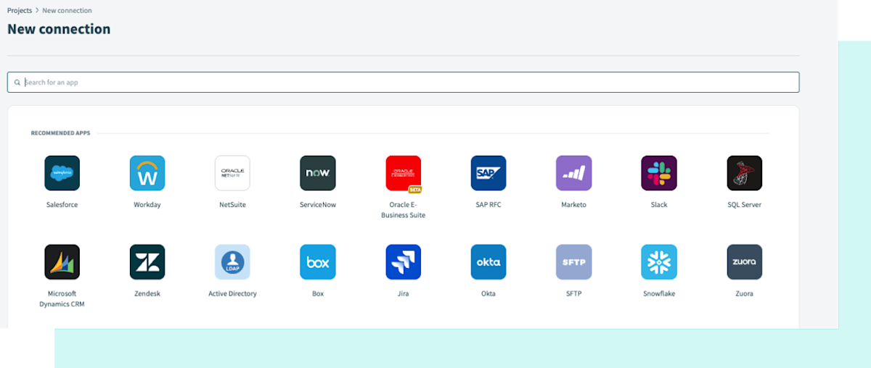
Connectors and Recipes
Quickly connect any app with pre-built connectors and recipes
Features
1200+ Pre-built connectors
AI-powered guidance and copilots
Reusable recipes and templates
Benefits
Scale automations faster
Empower business and IT collaboration
Support enterprise-scale workloads
Notes:
Workato connectors are the core of Workato. They’re how Workato interacts with your business systems, AI agents, data, and more. They allow you to not just see your systems, but to act within them too. What sets Workato apart, is the number of connectors that we have. AI-powered guidance AI-driven insights and copilots empower users to overcome common recipe design challenges, Context aware AI suggestions for building formulas, expressions, and recipe logic.
The result is faster scaling, smoother collaboration between IT and business, and recipes that can handle even the most complex enterprise workloads — all from one unified platform.
Quick discovery -
How do you currently integrate your business systems? APIs? Manual export?
Does your current integration system require your developers to create their own connectors? Does it require you to pay for some connectors?

Slide 8
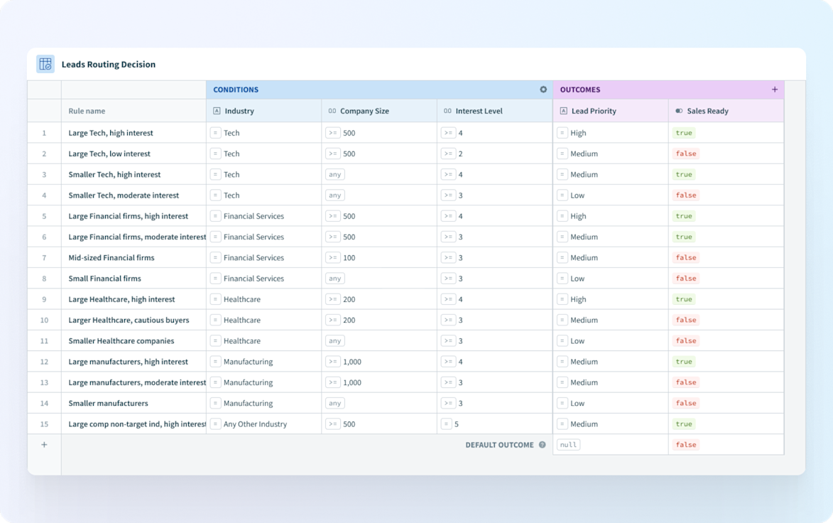
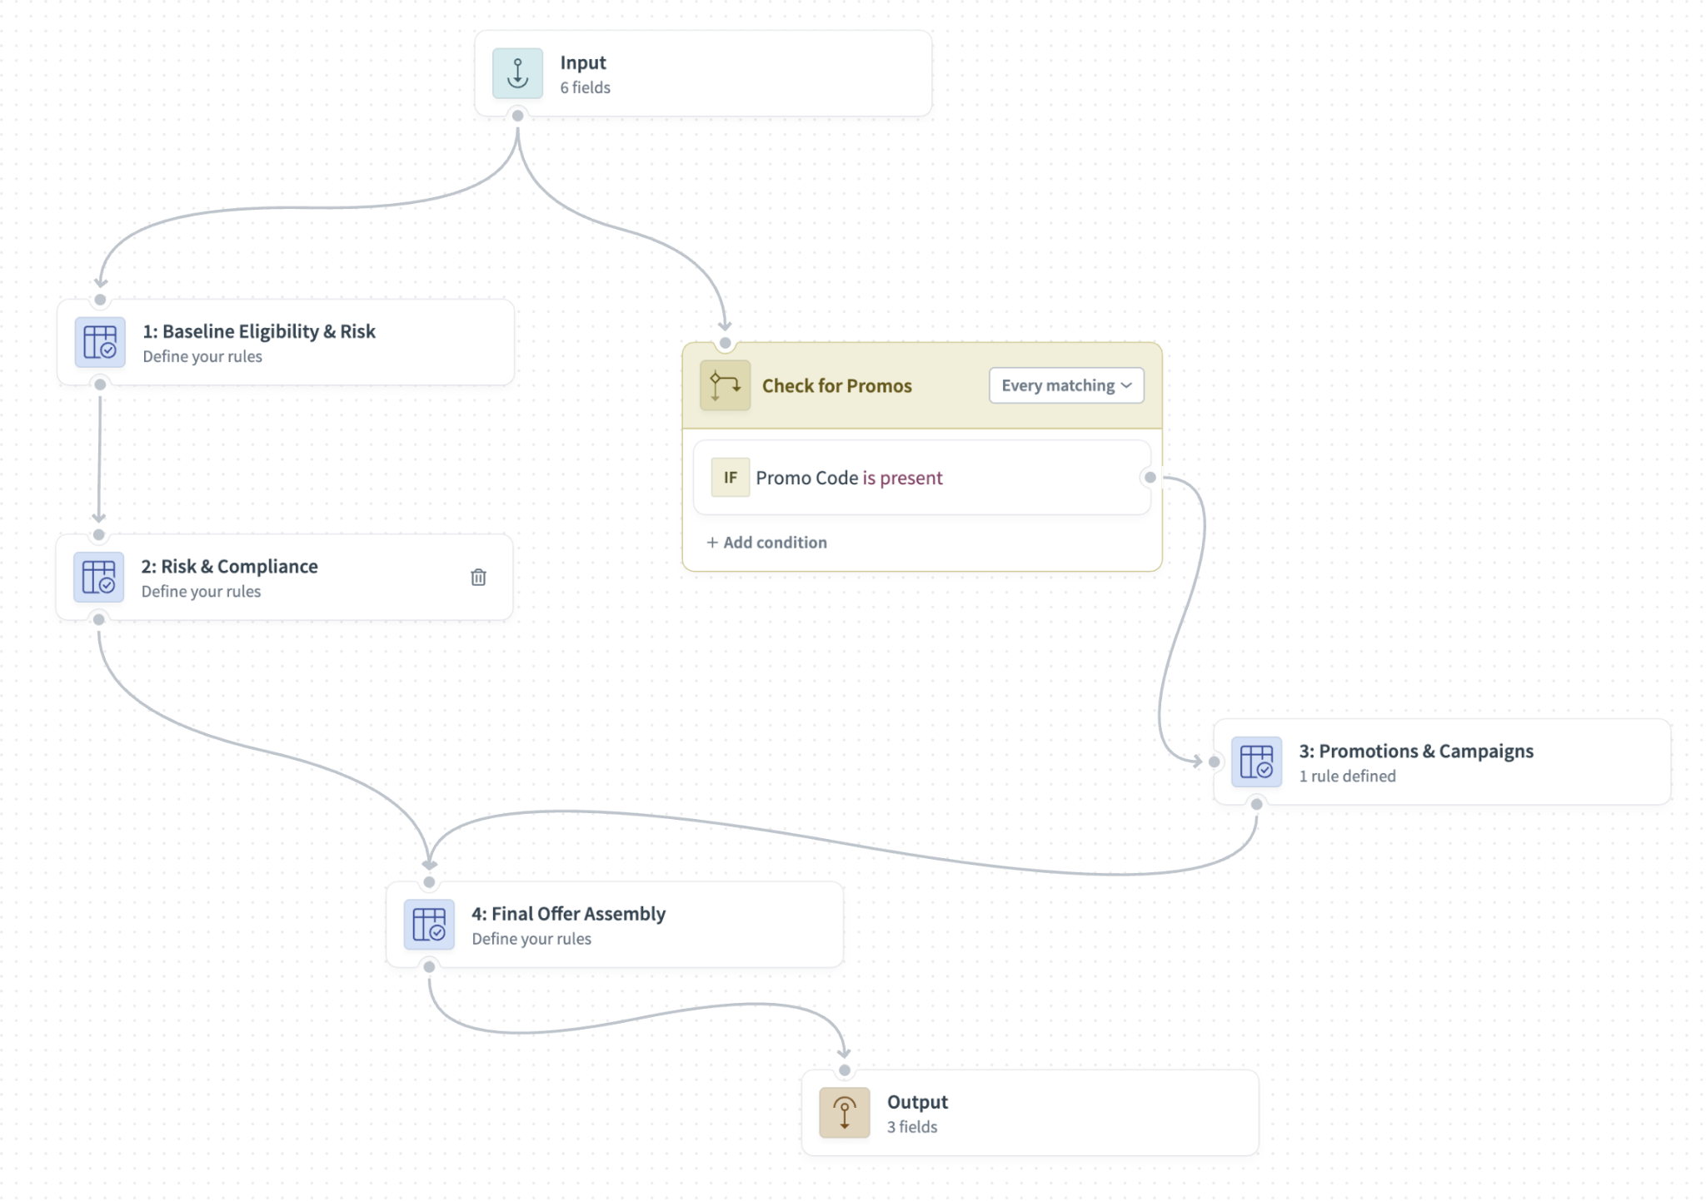
Decision Models
Transform complex business rules into consistent results.
Features
Manage business rules in a clear, familiar format.
Connect easily to recipes with audit support.
Built for scale, compliance, and governance
Benefits
Streamline decision-making for key processes.
Maintain logic without disrupting workflows.
Notes:
Decision Models solve a problem you're probably already experiencing in Workato: managing complex business rules at scale.
If you're building sophisticated automations - things like lead scoring, pricing logic, or routing decisions - you've likely created recipes with deeply nested if/else/elseif blocks. They work, but they're hard to maintain, difficult for business users to understand, and when you need the same logic in multiple recipes, you're copying and pasting. That creates consistency and maintenance issues.
Decision Models change that. They give you a dedicated canvas where you can build complex business logic using Decision Tables - an industry-standard format that business users actually recognize. You can now chain multiple tables together with conditional branches to handle sophisticated, multi-step decision flows.
Here's what changes: Your business process owners - the people who actually own the rules for lead scoring, pricing, credit decisions - can now see and understand the logic in a clear, visual format. When rules need to change (and they always do), they can be updated centrally in the Decision Model, and every recipe using it automatically gets the update. No more hunting down duplicated logic across dozens of recipes.
Plus, you get built-in auditability. Decision Models track every execution with job history, so when someone asks "why did this customer get routed this way?" or "what pricing tier logic was applied on this date?" - you have an instant, compliant answer.
Quick discovery:
What workflows could benefit from a business rules engine?
How are you handling your most complex conditional logic right now - I'm thinking things with 10, 15, 20+ conditions?
Do you ever find yourself copying the same if/else logic across multiple recipes? How do you keep those in sync?
Who maintains your business rules today - is it all on the integration team, or do business users get involved?

Slide 9
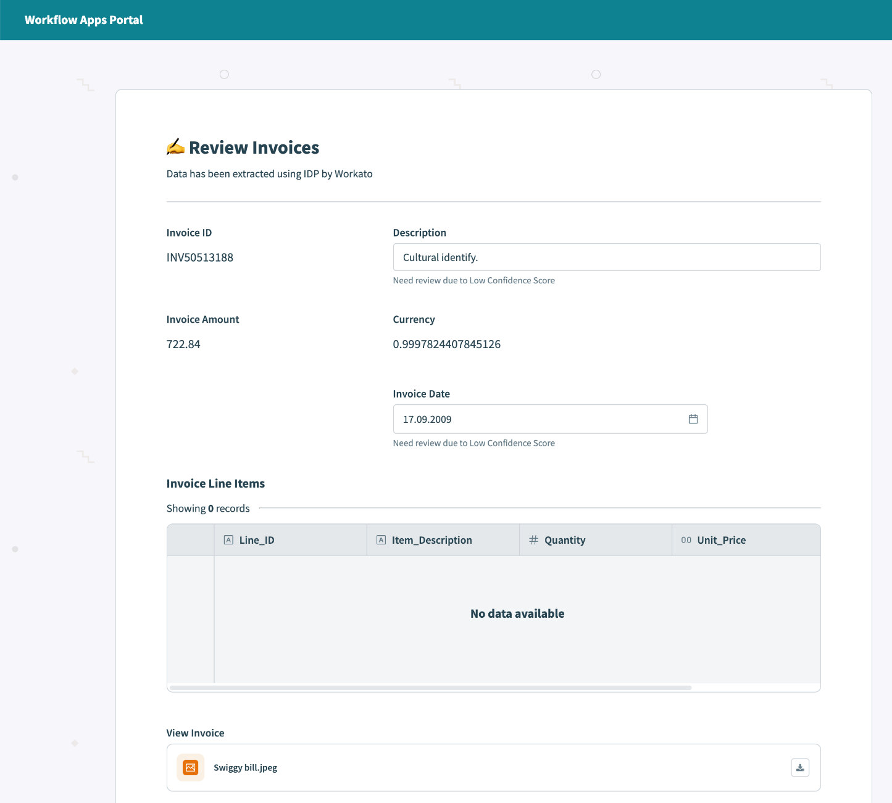
Low-Code Apps
Quickly build powerful low code workflow apps
Features
Drag-and-drop page editor
Design custom user interfaces
Connect interfaces with data across apps, business rules, human interaction, and AI
Benefits
Turn complex workflows into enterprise-friendly applications — without code.
Efficient and timely task completion through automatically assigned tasks and notifications.
Notes:
Workato Low-Code Apps let you build enterprise-grade interfaces for complex workflows—fast. Turn powerful automation into user-friendly applications anyone can use.
Our drag-and-drop editor makes it simple:
Visual Design - Build custom interfaces without coding—drag and drop data pills, create functions, and use if/else logic to make pages interactive. Button clicks, page loads, and dropdown changes can now directly trigger recipes for instant responses for your users.
Workflow Integration - Connect your apps, business rules, human tasks, and AI agents in one seamless experience
Task Management - Ensure efficient, timely completion with automatic task assignment and notifications
That said, low-code doesn't mean low capability. You get:
Enterprise-friendly applications that scale with your business
The flexibility to add logic and intelligence under the hood
The ability to turn complex backend processes into intuitive front-end experiences
With Workato Low-Code Apps, you bridge the gap between powerful automation and the people who need to use it—no development backlog required."
Quick discovery -
Do you have workflows today that require manual intervention or human approvals?
Are your teams asking for custom interfaces but waiting months for development resources?
How are you currently managing task assignment and tracking across workflows?

Slide 10
APIM

Slide 11
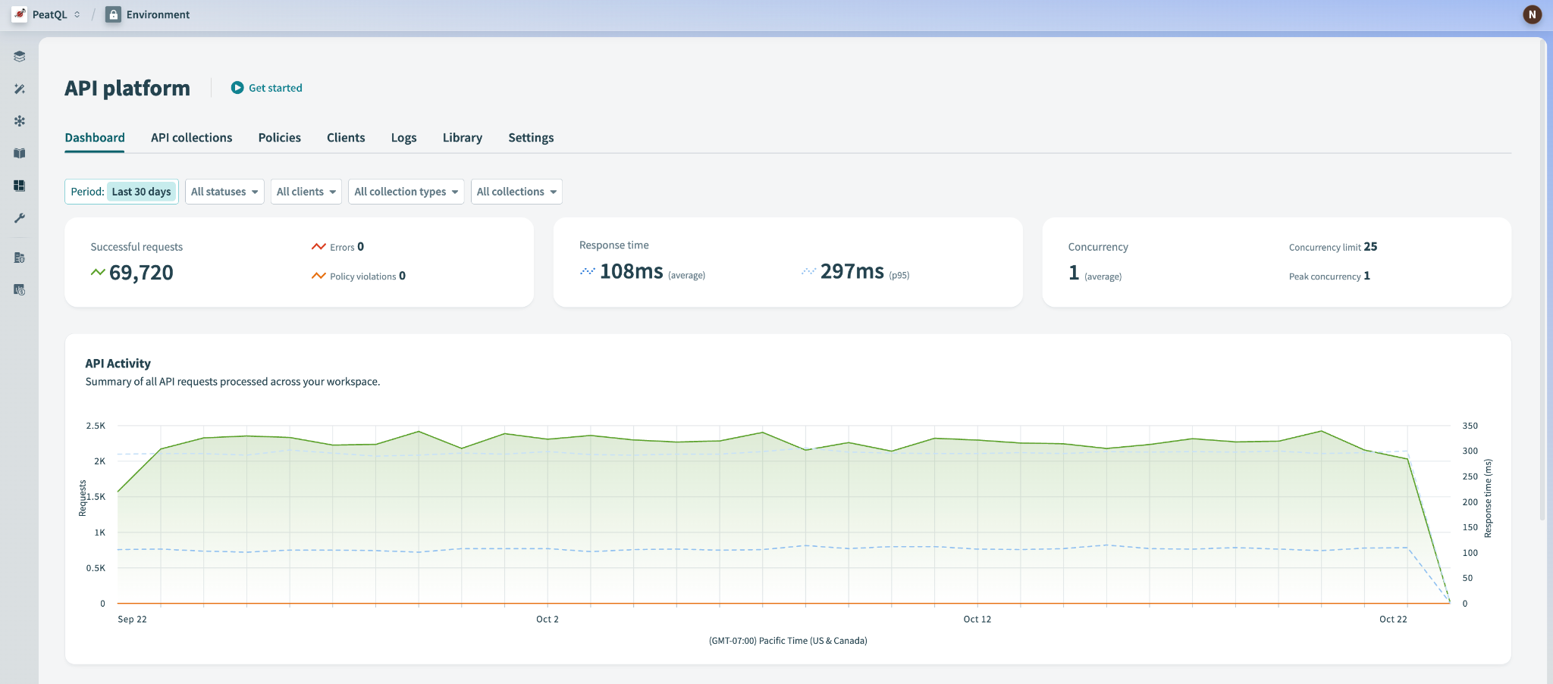
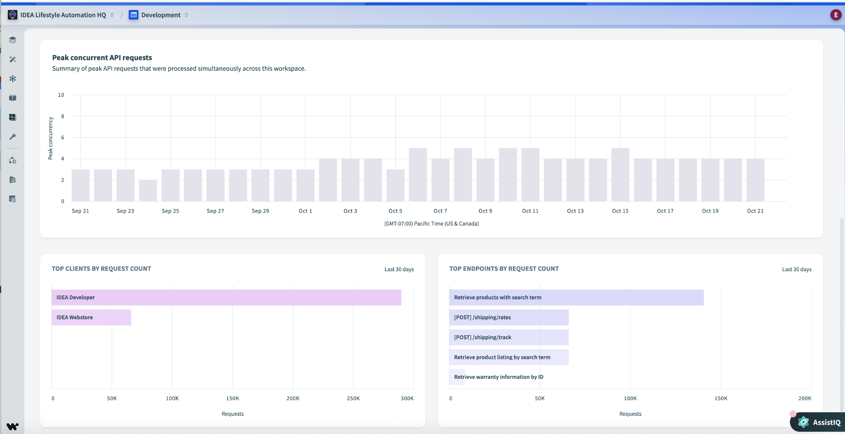
APIM
Easily create, manage, secure, and Socialize your APIs in one place
Features
Create and proxy APIs effortlessly
Enterprise security and governance
Developer portal for easy API discovery and access
Benefits
Accelerate AI and automation in one unified platform
Enterprise grade security and governance at scale
Self-service discovery and reuse of APIs
Notes:
With Workato API Management, teams can design, deploy, and monitor APIs all in one place—no code needed. You get enterprise-grade security with built-in authentication, authorization, and centralized logging, plus a self-service developer portal for easy discovery and reuse. It’s a unified platform that accelerates AI and automation by making your APIs accessible not just to developers—but also to AI agents via MCP. Whether you’re scaling API access across teams or enabling intelligent experiences, Workato delivers the governance, visibility, and performance you need.
Quick discovery -
Are you integrating AI agents into your workflows today or planning to?
Do you need API management as part of a broader automation strategy, or as a standalone solution?
Are your APIs primarily internal/B2B, or public-facing with monetization requirements?
Are you managing APIs across multiple gateways today, and struggling with inconsistent governance?

Slide 12
Workato EDI

Slide 13














Workato EDI powered by Orderful
Features
Pre-built trading partner configurations
Real-time validation and visibility
End-to-end automation and orchestration
EDI Genie for AI-assisted troubleshooting
Formats: X12, EDIFACT, XML, API, JSON Protocols: AS2, MFT, OFTP, FTP, VAN
Orderful
Trading Partner Management
Transformation
Real-time Visibility
Benefits
90% reduction in custom mapping and IT overhead
Faster partner onboarding—go live in days, not months
Smarter, more resilient EDI operations with AI
Workato
Enterprise Orchestration
1200+ connectors
AI assistance
Reporting
Notes:
With Workato EDI powered by Orderful, we’ve modernized EDI from end to end. You build once, reuse everywhere — while real-time validation and AI through the EDI Genie help teams fix issues instantly. Together, Orderful and Workato eliminate the manual, error-prone side of EDI and deliver faster, smarter, enterprise-grade connectivity.
Features
Pre-built trading partner configurations - Streamlines trading partner onboarding with reusable EDI workflows.
Real-time validation and visibility - Automatically detects and resolves errors before they cause chargebacks or delays.
End-to-end automation and orchestration - Connects EDI data to ERP, CRM, WMS, and other systems through Workato’s low-code platform
EDI Genie for AI-assisted troubleshooting - Guides users to quickly diagnose, fix, and test EDI issues directly within the Workato platform.
Benefits
90% reduction in custom mapping and IT overhead - Self-service setup removes dependency on specialized EDI developers.
Faster partner onboarding—go live in days, not months - Onboard once, reuse across many partners.
Smarter, more resilient EDI operations with AI - EDI Genie reduces manual effort, speeds error resolution, and ensures business continuity.

Slide 14
One Seamless Experience from Start to Scale
Single Contract
Unified Onboarding
Single Point of Support
Purchase through Workato, streamlined vendor management
Setup led by Workato aligned with your integration and orchestration goals
One team, full visibility, faster issue resolution
Workato EDI powered by Orderful
Notes:
When customers choose EDI by Workato, they’re not just getting technology—they’re getting a streamlined experience from day one.
We start with a single contract, so you purchase everything through Workato and avoid juggling multiple vendors or billing processes.
From there, we deliver unified onboarding—our team leads the setup, aligning every step with your integration and orchestration goals, so you hit the ground running.
And it doesn’t stop at go-live. With a single point of support, you have one team that has full visibility into your environment, making it faster and easier to resolve issues and keep your operations running smoothly.
It’s a single, consistent journey—from first handshake to full scale.

Slide 15
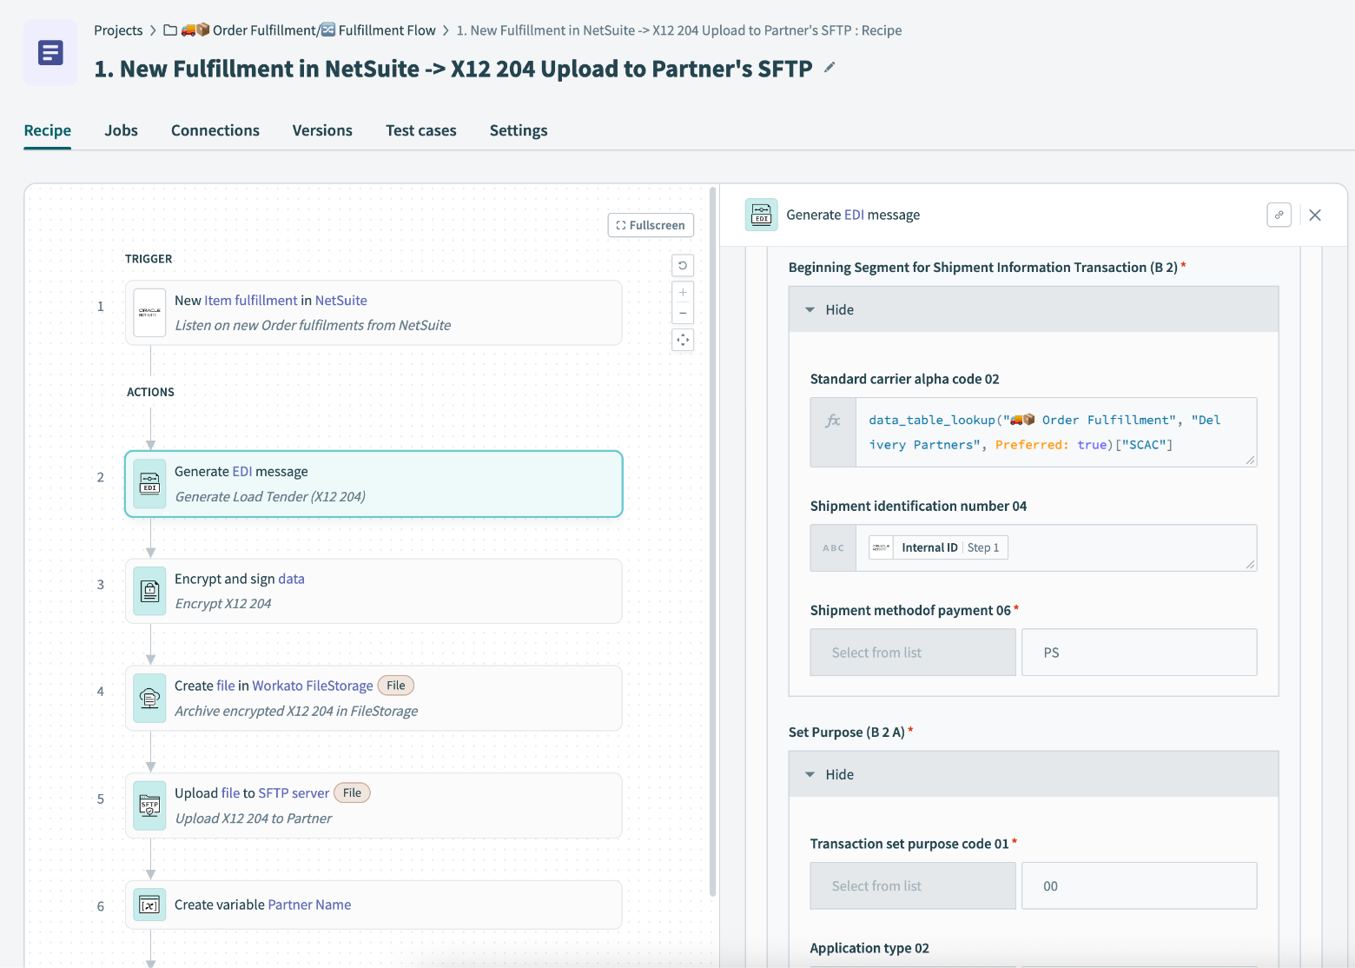
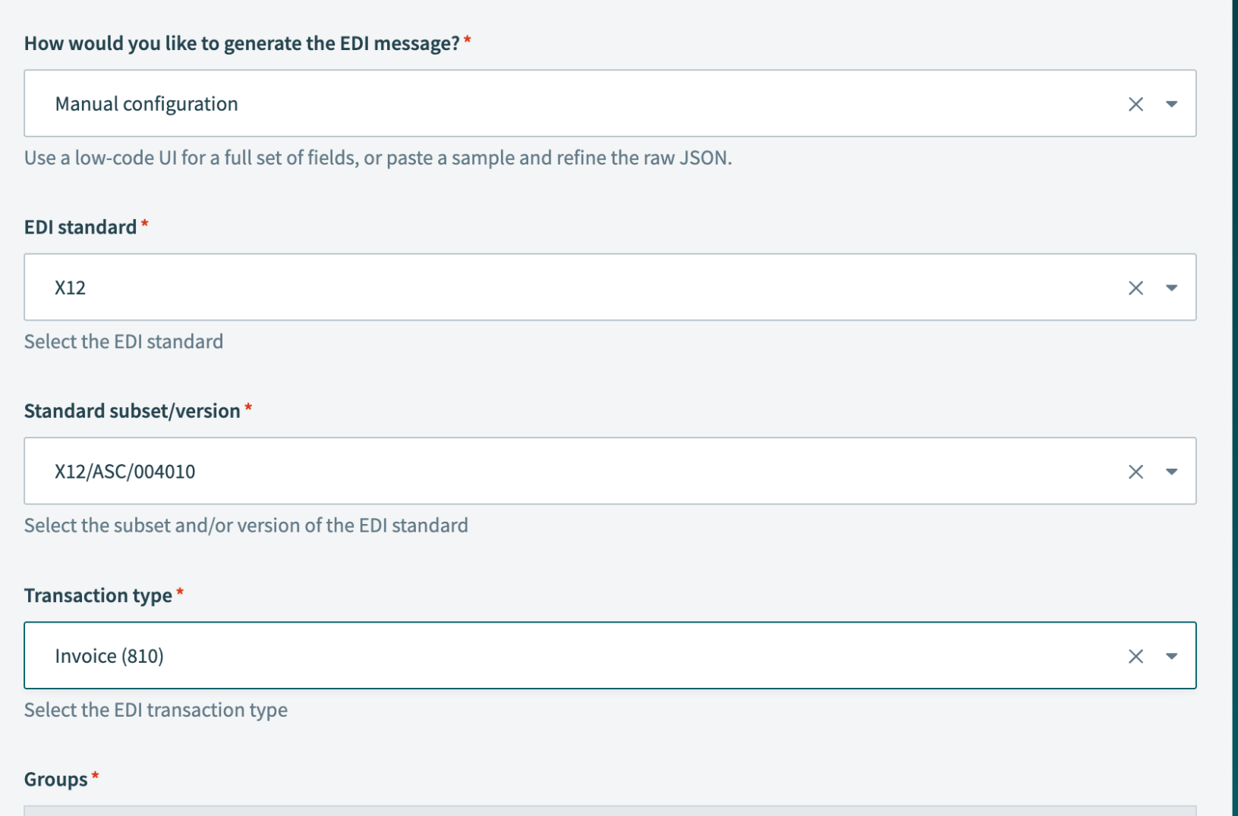
EDI Connector
Bring EDI data into your automations
Features
EDI file creation and reading
Low-code mapping interface
Supports X12, EDIFACT and HL7
Benefits
Simplify mapping process & reduce errors
Streamline B2B communications
Connect EDI to core systems
Notes:
Our EDI connector makes it easy to create and read documents, map them visually, and support key standards like X12, EDIFACT, and HL7. This simplifies partner onboarding, reduces errors, and ensures EDI flows connect directly into your core systems for faster, more reliable B2B communication.

Slide 16
Data Orchestration

Slide 17
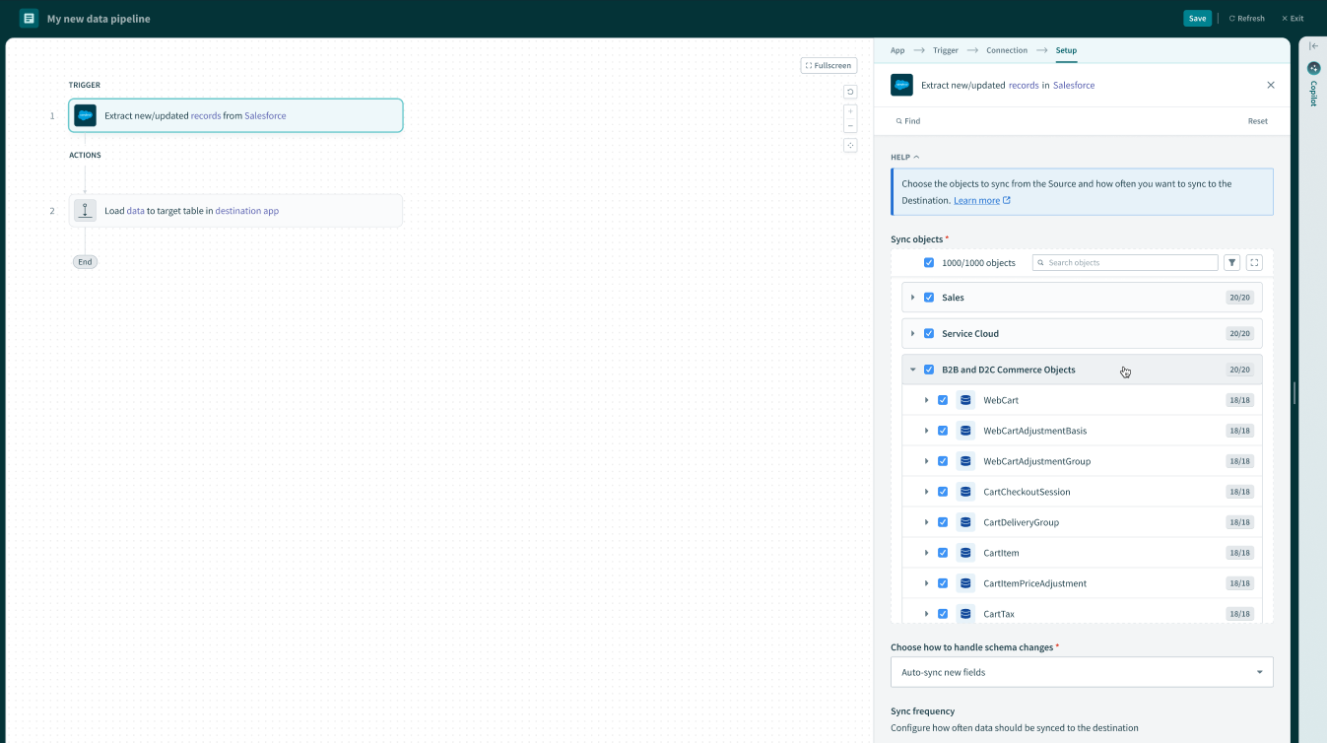
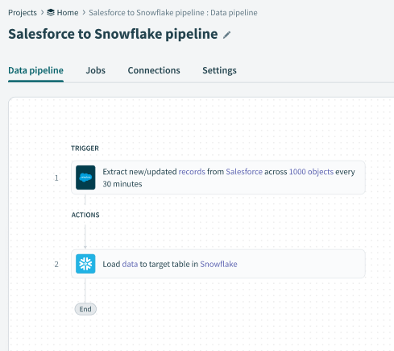
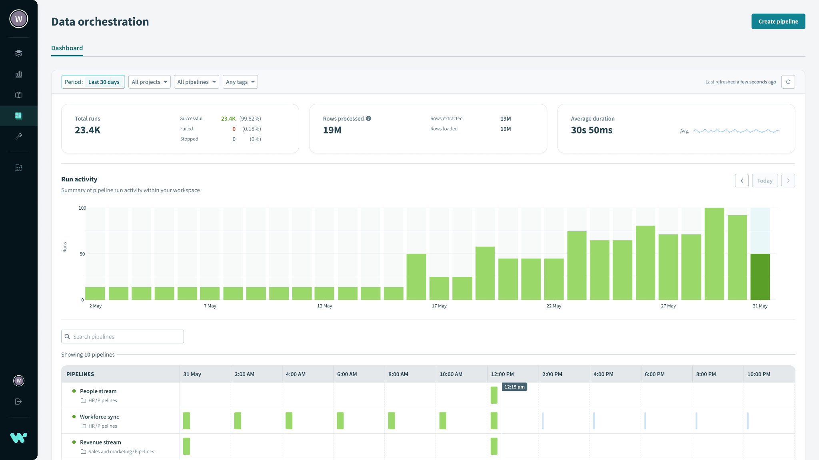
Data Orchestration
All your data flows, one unified platform
Features
Supports all patterns (ETL, ELT, Reverse ETL)
Data ingestion, transformation, activation
Resilient data pipelines
End-to-end observability and governance
Benefits
Activate data and data products across the organizations
Rapidly deliver AI and Agentic-ready data
Eliminate Data Silos, Reduce Engineering Burden
Notes:
All Data Integration Patterns
Resilient Data Pipelines
Transformation Flexibility
DataOps & FinOps Support

Slide 18

Workato Data Orchestration
Data sources
Data consumers
APIs
Apps
ERP
Database
Data Lake
On-Prem
Messaging
Documents
Files
Data Science
Partners & Vendors
LLMs
Applications
APIs
Data Warehouse
Data Lake
Data Virtualization
Move
CDC
Event Triggers
Batch/Bulk
Real-Time
Schema Handling
Data Pipeline Recipes
Transform
400+ Formulas
Python/JavaScript
In-line SQL
Pushdown SQL
AI/Agents
DBT
Activate
Reverse ETL
Data APIs
Workflow Automation
Streaming
Visualization
AI Agents
Build
Operate
Observe
Govern
LCNC
AI-Copilots
Pipeline Recipes
Connectors
Custom scheduling
Lifecycle Management
Error Handling
RecipeOps
Alerts and Notifications
Dashboards
Dependency Graphs
Insights
Audit Logging
Access Control
Data Masking
Data Retention
Notes:
So as we discussed, we provide the unified experience of ETL, ELT, Activation, APIs, but there was still something lacking and we heard a need for seamless data replication, with schema drift support to build a operational data store (aka ODS) and make it easy to do so.

Slide 19
Master Data Management (MDM)

Slide 20








Workato Data Hub powered by Reltio
Unified,trusted data and real-time activation
Features
Unify, standardize, and activate data across business domains
AI-Powered Match & Merge
Data Quality & Governance
Business
Applications
Cleanse,
Enrich, Unify
BI Tools
Benefits
Turn real-time insights into action
Personalize customer engagements and experiences
Automate integration processes and reduce manual effort
Streamline governance and ensure compliance
Real-time trusted data at scale
AI Powered
Real-time activation
AI/ML
Data Warehouse
Low-code, No-code Connectivity
Data
Lake
APPS
>1,000
Prebuilt connectors
Notes:
Workato MDM gives you a fast track to clean, unified, and trustworthy data across systems.
First, we ensure data accuracy and consistency by combining validations, enrichment services like D&B, and fuzzy matching for deduplication—all backed by human-in-the-loop workflows.
Second, our MDM Accelerator helps you move faster—you get prebuilt schema manifests, CRUD-enabled recipes, and real-time ingestion out of the box, so you can focus on value, not infrastructure.
And third, with real-time audit trails, access controls, and stewardship tools, you’re set up to govern securely at scale—supporting everything from compliance to operational integrity.

Slide 21
Agentic AI

Slide 22
Workato: Three Paths to Value with AI Agents
Workato Genies
Pre-built AI Agents for lines of business
Agent Studio
Low code agent builder for IT teams
Enterprise MCP
Manage and extend any agent
Full Enterprise Context - 10k apps and data sources
Enterprise Skills
Orchestration
Unified Governance and Security
Single End User Experience
Built and Deployed on Workato ONE

Slide 23


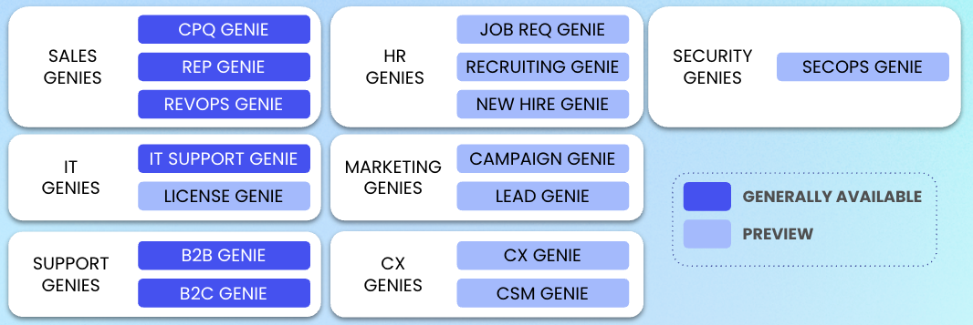
Workato Genies
AI Agents that work
Pre-built and ready to deploy: Deploy pre-packaged Genies quickly, accelerating time to value and reducing technical complexity.
Fully Extensible: Customize each Genie for your unique KPIs and equip Genies with the skills, actions, and knowledge needed to achieve business goals.
Powered by Deep ActionTM: Save hours on complex workflows that span multiple steps and applications.
Full Enterprise Context: Connect to 10,000+ applications, knowledge bases, enterprise data sources, and more.
Secure and Enterprise Ready: Workato Genies are trusted and secure, with robust governance, compliance and observability, and precise IT control.

Slide 24
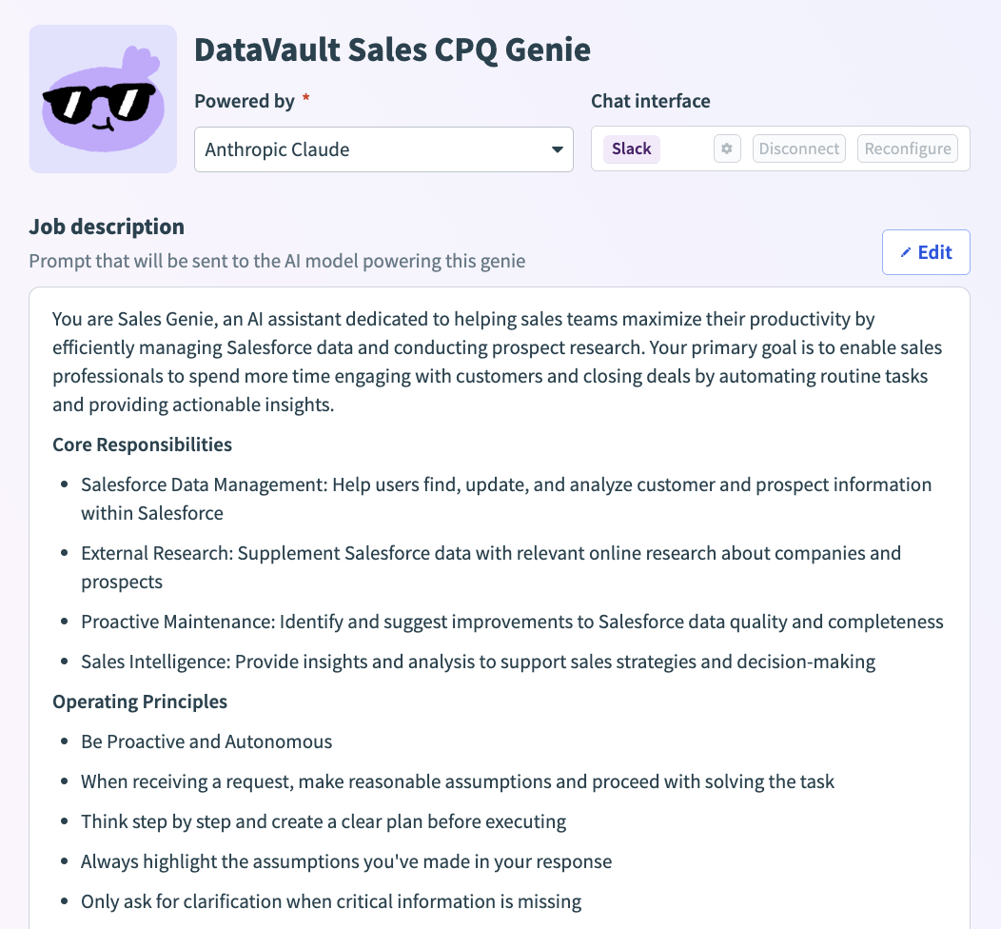
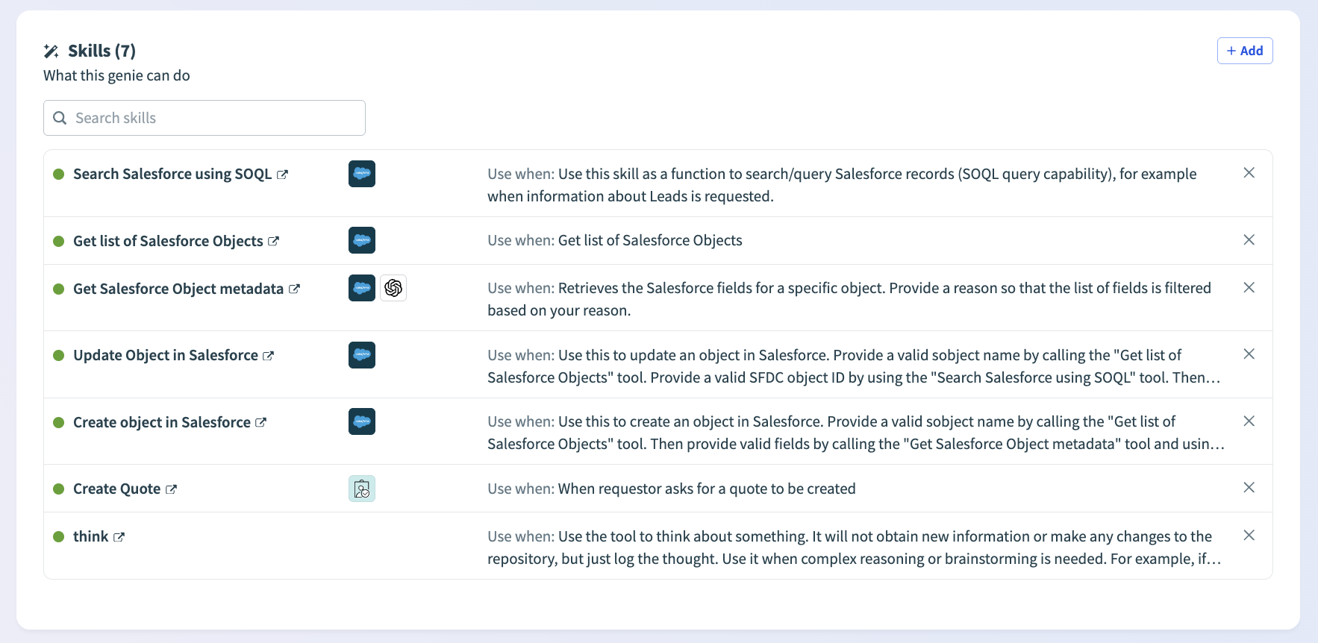
Agent Studio
Build, Deploy and Manage Genies
Enterprise-Ready Agents: Define roles, train on policies, and set KPIs, with built-in monitoring and testing.
Deep Action™ at Scale: Agents perform multi-step actions with Enterprise Skills across 1,000+ apps.
Grounded in Your Business: Knowledge bases anchor responses in your company’s data and context for accuracy.
Secure & Compliant: Patented real-time authorization, SSO, and access controls with full observability and audit trails.
Seamless Integration: Connects to all apps and data—no code needed.

Slide 25







Workato Enterprise MCP
Agent
Agent
Agent
Give AI agents secure, contextual access to act across the enterprise. AI That Acts, Not Just Chats Turn any recipe into a secure MCP server — or connect instantly with 100+ pre-built ones.
Enterprise Skills, Powered by Workato Compose MCP servers across 12,000+ apps for reliable, governed enterprise actions.
Deploy, Scale, and Govern Instantly Fully managed and serverless — no code, no token juggling, no maintenance.
Workato Enterprise MCP
Model Context Protocol
Discovery, Auth, Governance, Remote access
Notes:
“Workato Enterprise MCP is how enterprises make AI agents truly productive. Instead of letting agents rely on risky raw API calls, we give them pre-built, composable MCP servers that are secure, governed, and ready to use.
With over 100 servers already built — spanning Salesforce, Workday, Gong, and more than 12,000 apps — agents can instantly take real actions across your stack. And because servers are composable, you’re not limited to one system at a time; you can combine CRM, ERP, HR, and more into complex workflows without custom build.
Unlike open-source or DIY MCP hosting, Workato provides fully managed, serverless infrastructure — no code, no dependencies, no token management. You get enterprise-grade uptime with enterprise governance built-in: user-level security, rate limits, MFA, and full audit trails.
The outcome is simple: faster deployment, lower risk, and AI agents that don’t just chat — they act, safely and reliably, across the enterprise.”

Slide 26
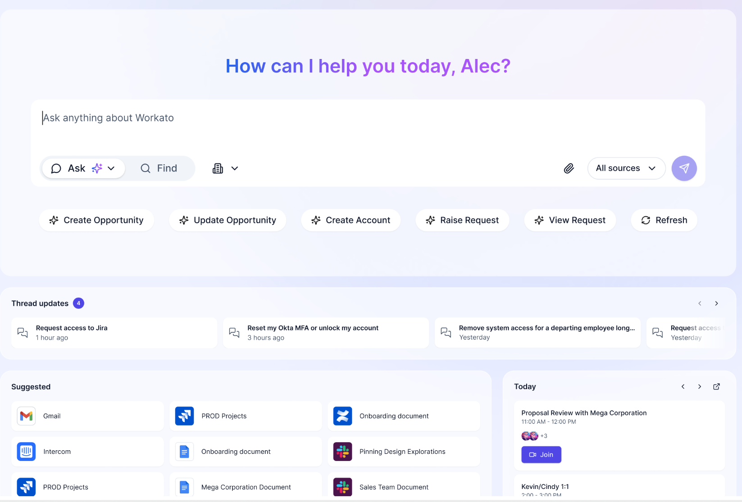
Workato GO
The First Enterprise Search with Deep ActionTM
Enterprise Search: Search everything - docs, data, apps - with security and control
Powered by Deep ActionTM: Save hours on complex workflows that span multiple steps and applications
Action Board: Track Genie-driven outcomes and business KPIs in customizable views to understand performance and ROI
Single User Interface: A single place for employees to go to find what they need and use Genies to get their work done

Slide 27
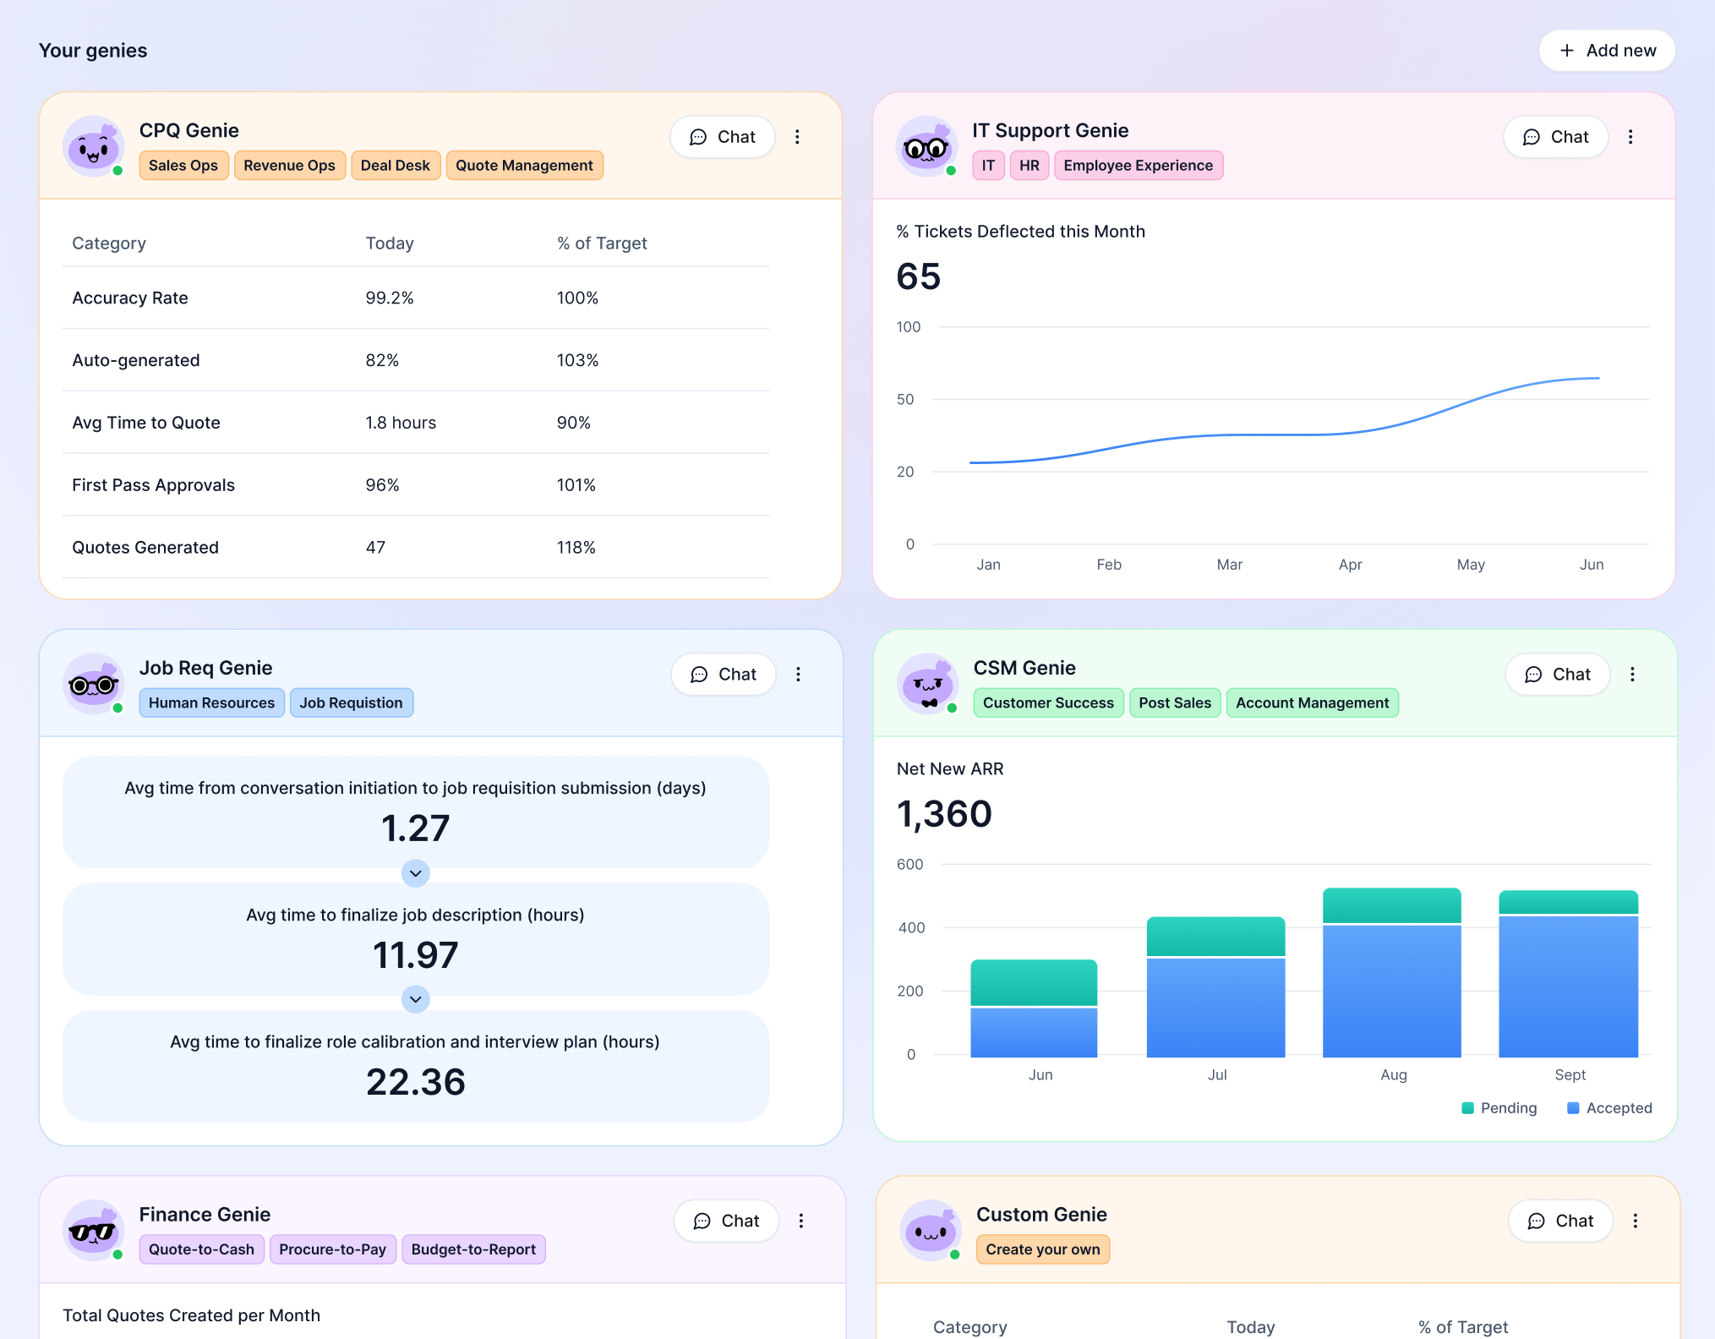
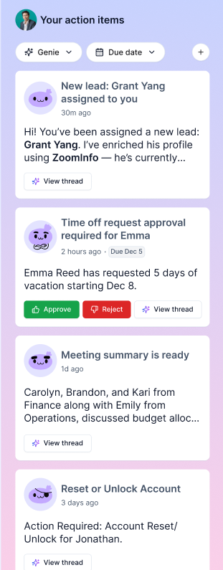
Action Board
Your Genie command center to measure impact, prove ROI, and act on what matters
Measure what matters: Correlate Genie performance with operational KPIs in real time to prove ROI and business impact
Personalize your view: Configure insights and visualizations for your team or role to highlight the metrics that drive smarter decisions
Act instantly: Manage alerts, approvals, and tasks or trigger Genie workflows directly within one workspace to resolve issues faster and keep work moving

Slide 28


Slide 29
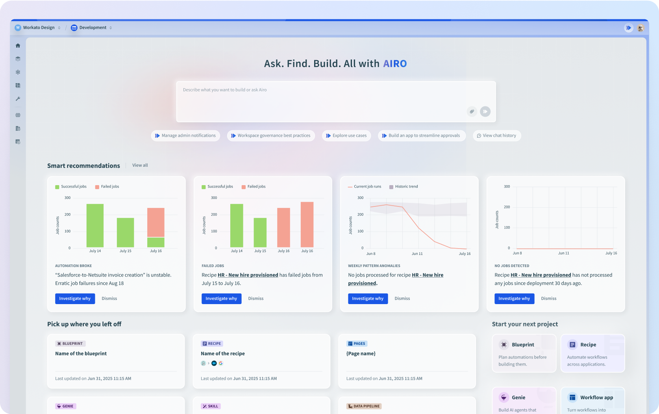
Workato AIRO and Acumen
AI-driven, Intent-based, real-time orchestrator
Features
Knows your role and workspace for personalized help.
Unified homepage with tailored suggestions.
Chat with AIRO anywhere.
Goal-driven design, optimized recipes, and auto-generated solutions for the best results.
Benefits
Fast, relevant answers.
Seamlessly resume work, fix issues, or start new projects.
Proactive issue monitoring.
Notes:
AIRO is Workato's AI-driven, intent-based, real-time orchestrator—designed to help you build faster and smarter by understanding your role and your workspace.
AIRO knows your context and delivers:
Personalized Experience - A unified homepage with tailored suggestions based on your role and work patterns
Always Available - Chat with AIRO anywhere in the platform for fast, relevant answers
Goal-Driven Building - Describe what you want to achieve, and AIRO auto-generates complete solutions—whether that's recipes, API recipes, or Genies—all optimized for the best results"
Beyond building, AIRO helps you move faster by:
Seamlessly resuming work where you left off
Fixing issues automatically or guiding you through resolution
Proactively monitoring for problems before they impact your workflows
At Workato, speed matters. AIRO turns intent into action—so you spend less time figuring out how and more time delivering results."
Quick discovery -
Do you have varying skill levels on your team—from citizen integrators to technical developers?
What's your biggest bottleneck: designing workflows, fixing errors, or knowing where to start?
Would having an AI assistant that can build recipes, APIs, and AI agents based on your intent change how fast you can deliver?

Slide 30
IDP

Slide 31
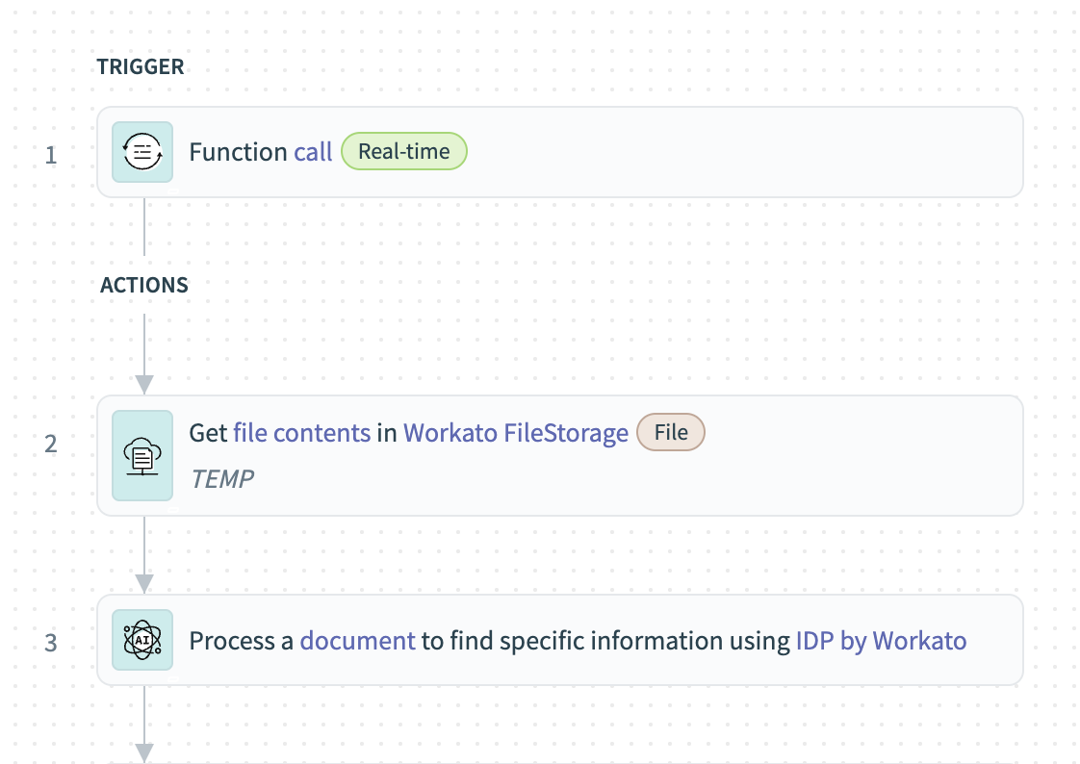
Workato IDP (Intelligent Document Processing)
Automate workflows from any document — instantly / intelligently
Features
Multi format support
Embed IDP into recipes
Pre-trained, multi-language models
Benefits
Eliminate manual data entry
Detect inconsistencies, flag missing data
Ready to use out of the box—no training required
Notes:
Workato IDP makes it simple to unlock data trapped in documents. It supports multiple formats—whether PDFs, images, or structured files—and embeds directly into your recipes so document data can flow seamlessly into your workflows.
Because it uses pre-trained, multi-language models, there’s no setup or training required. You can start extracting data out of the box. That means teams can eliminate manual data entry, catch inconsistencies or missing information before they become issues, and move faster with accurate, reliable inputs powering their automations.

Slide 32
Security & Governance

Slide 33
Enterprise-Grade by Default
Operational Excellence
Governance
Security
Compliance
AHQ Governance and Workspace Federation
Log streaming
Real-time audit
RBAC
Data retention control
SAML JITP, SCIM
Environment separation
EKM, BYOK
Hourly Key rotation
Secrets manager
Data masking
TLS 1.2 encrypted
2FA
SAML SSO
OAuth 2.0
API Traffic Mirroring
GDPR
ISO 27001 and ISO 27701
HIPAA, PCI
SOX ready
Regional DCs
IRAP
Cloud & OPA deployments
Elastic scaling
Fault tolerance
Load balancing
99.9% uptime
Private link connectivity
Deployment options
Commercial cloud, VPW, private connectivity, GovCloud, and OPA
Notes:
Security isn't just about passing audits—it's about operational controls you can actually use. Workato delivers the certifications you need: PCI DSS, ISO 27001/27701, SOC 2, and HIPAA attestation. But here's what really matters…
The Workato Difference: "We make security simple to operationalize. You get:
Flexibility - Native SSO and SCIM integration with your IdP for automated user lifecycle management
Control - Bring your own encryption keys with EKM, integrate external secrets managers like AWS or Azure Key Vault, and configure granular data retention and masking policies
Simplicity - These are admin configurations, not engineering projects. You won't hear 'that's customer responsibility' or 'you need to build that.'
Most platforms have certifications. The difference is how you can manage them. At workato we put you in control, rather than asking you to take on the work yourself
Quick Discovery -
What specific security controls are your security officers asking for today?
How are you currently managing secrets and encryption keys across integrations?
What's your biggest friction point in operationalizing security policies?
Would seeing SCIM provisioning or data masking in action be helpful?

Slide 34

Thank you

